Slide 1


DevOps
Jenkin & Docker

Slide 2


Agenda
1) Introduction to CI/CD, Jenkins Integration with Java, Git, Maven
2) Jenkins installation & Overview of Jenkins UI
3) Configuring Jenkins: Configure System, Environment Variables, URL, Configuring Jenkins task
4) Configure & run Jenkins pipe & Job
5) Introduction to Docker
6) Containerization
7) Docker architecture
8) Docker basic commands
9) Building & uploading your own docker image 10) Integrate docker with Jenkins

Slide 3
1) Introduction to CI/CD, Jenkins Integration with Java, Git, Maven

Slide 4
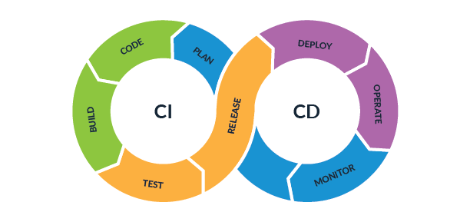
CI/CD

Slide 5
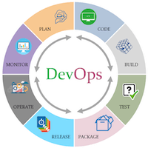
CI/CD
Introducing devops (CI/CD)

Slide 6
DevOps
The DevOps is the combination of two words, one is Development and other is Operations.
It is a culture to promote the development and operation process collectively.
This allows a single team to handle the entire application lifecycle, from development to testing, deployment, and operations.
DevOps helps you to reduce the disconnection between software developers, quality assurance (QA) engineers, and system administrators.
DevOps tools such as Git, Ansible, Docker, Puppet, Jenkins, Chef, Nagios, and Kubernetes.

Slide 7
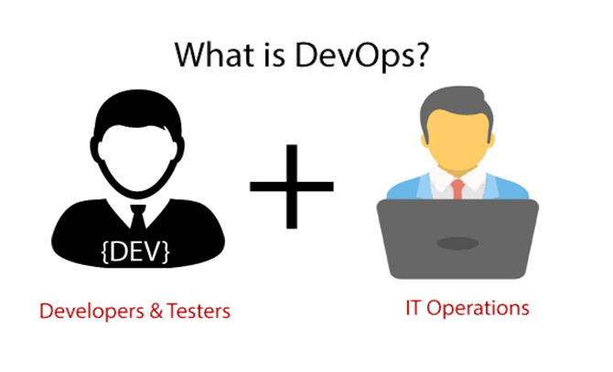
DevOps promotes collaboration between Development and Operations team to deploy code to production faster in an automated & repeatable way.
DevOps is nothing but a practice or methodology of making "Developers" and "Operations" folks work together. DevOps represents a change in the IT culture with a complete focus on rapid IT service delivery through the adoption of agile practices in the context of a system-oriented approach

Slide 8
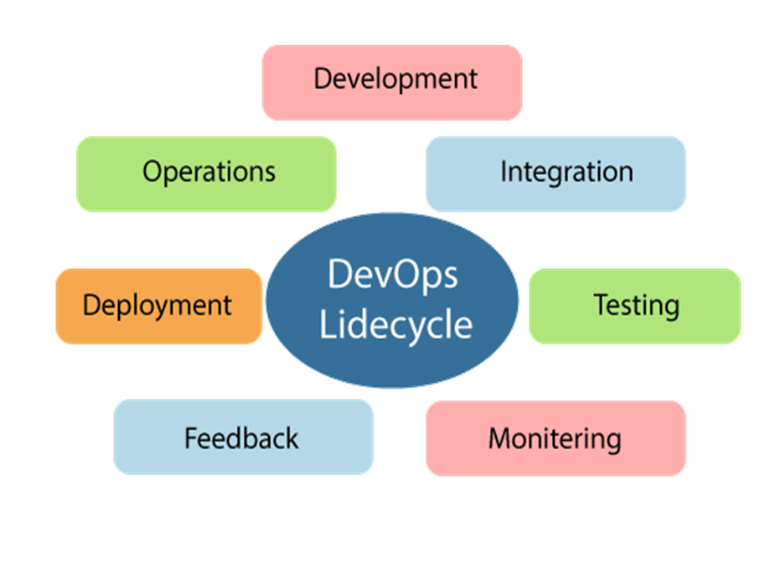
DevOps Lifecycle

Slide 9
1) Continuous Development
This phase involves the planning and coding of the software.
The vision of the project is decided during the planning phase.
And the developers begin developing the code for the application.
There are no DevOps tools that are required for planning, but there are several tools for maintaining the code.

Slide 10
2) Continuous Integration
This stage is the heart of the entire DevOps lifecycle.
It is a software development practice in which the developers require to commit changes to the source code more frequently.
This may be on a daily or weekly basis. Then every commit is built, and this allows early detection of problems if they are present.
Building code is not only involved compilation, but it also includes unit testing, integration testing, code review, and packaging.

Slide 11
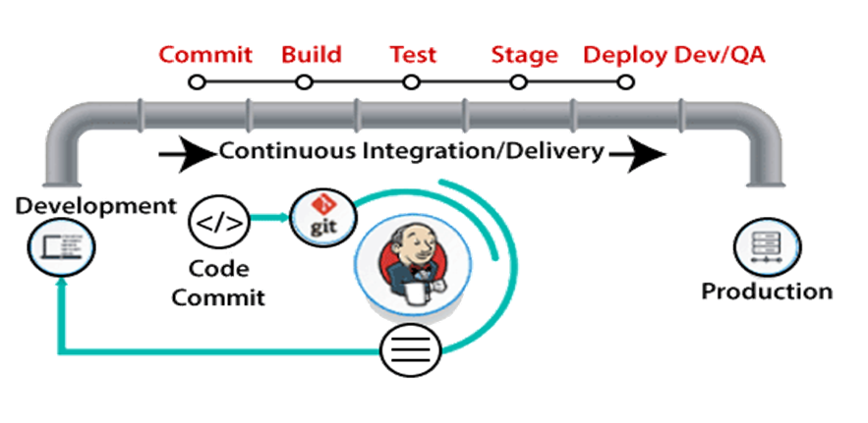
The code supporting new functionality is continuously integrated with the existing code.
Therefore, there is continuous development of software. The updated code needs to be integrated continuously and smoothly with the systems to reflect changes to the end-users.

Slide 12
DevOps Pipeline
A pipeline in software engineering team is a set of automated processes which allows DevOps professionals and developer to reliably and efficiently compile, build, and deploy their code to their production compute platforms.
The most common components of a pipeline in DevOps are build automation or continuous integration, test automation, and deployment automation.
Continuous Integration Pipeline
Continuous Delivery Pipeline

Slide 13
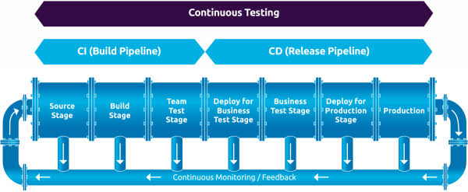

Slide 14
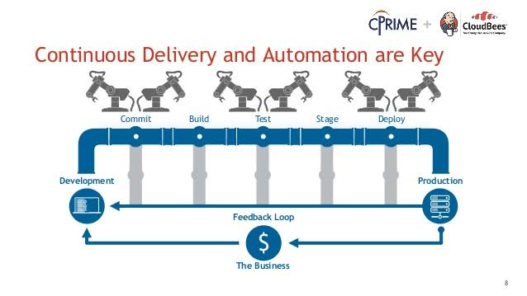


Slide 15
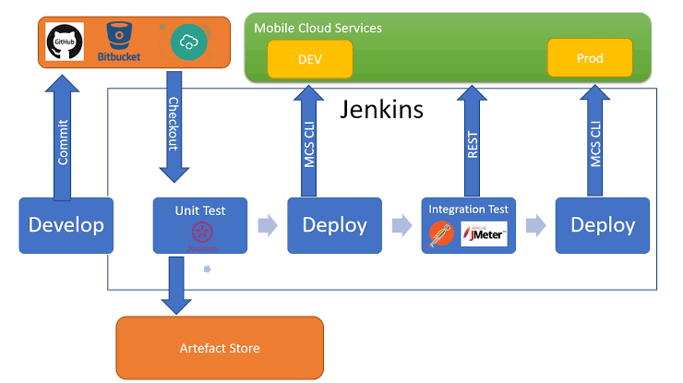

Slide 16
2) Jenkins installation & Overview of Jenkins UI
Refer
https://www.jenkins.io/doc/book/installing/
https://www.jenkins.io/doc/book/installing/windows/

Slide 17
3) Configuring Jenkins: Configure System, Environment Variables, URL, Configuring Jenkins task
Reference Link
https://phoenixnap.com/kb/jenkins-environment-variables
Fixing a root url : https://docs.cloudbees.com/docs/cloudbees-devoptics/latest/install-guide/install-troubleshoot

Slide 18
4) Configure & run Jenkins pipe & Job
Refernce
https://www.jenkins.io/pipeline/getting-started-pipelines/

Slide 19
Reference Link
Jenkin - https://www.jenkins.io/doc/pipeline/tour/getting-started/
Docker Download: https://docs.docker.com/desktop/windows/install/
Download the Linux kernel update package:https://docs.microsoft.com/en-us/windows/wsl/install-manual#step-4---download-the-linux-kernel-update-package
GitHub Setup for Jenkins: https://www.javatpoint.com/github-setup-for-jenkins
Jenkins Maven Setup: https://www.javatpoint.com/jenkins-maven-setup

Slide 20
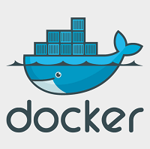

Slide 21
What is Docker?
Docker is an open-source centralized platform designed to create, deploy, and run applications.
Docker uses container on the host's operating system to run applications. It allows applications to use the same Linux kernel as a system on the host computer, rather than creating a whole virtual operating system.
Containers ensure that our application works in any environment like development, test, or production.
Docker includes components such as Docker client, Docker server, Docker machine, Docker hub, Docker composes, etc

Slide 22
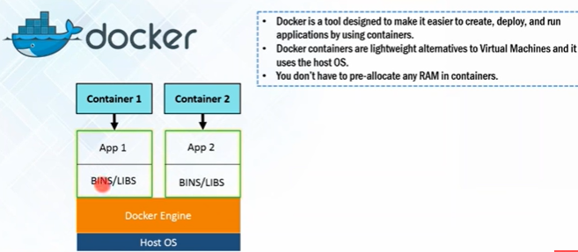
Docker : define
Docker is a tool that allows developers, sys-admins etc. to easily deploy their applications in a sandbox (called containers) to run on the host operating system i.e. Linux.
The key benefit of Docker is that it allows users to package an application with all of its dependencies into a standardized unit for software development.
Unlike virtual machines, containers do not have high overhead and hence enable more efficient usage of the underlying system and resources.
Docker is a tool designed to make it easier to create, deploy, and run applications by using containers.

Slide 23
Docker Containers
Docker containers are the lightweight alternatives of the virtual machine.
It allows developers to package up the application with all its libraries and dependencies, and ship it as a single package.
The advantage of using a docker container is that you don't need to allocate any RAM and disk space for the applications.
It automatically generates storage and space according to the application requirement.

Slide 24
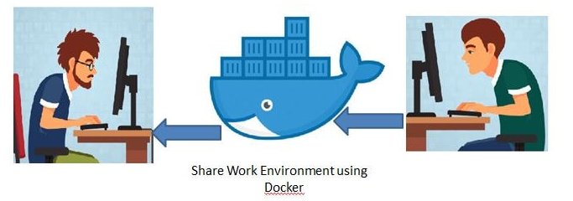
Containers : define
Containers allow a developer to package up an application with all of the parts it needs, such as libraries and other dependencies, and ship it all out as one package.
Create self-contained development environments inside Docker containers.
So we share an environment already configured.

Slide 25
Virtual Machine
A virtual machine is a software that allows us to install and use other operating systems (Windows, Linux, and Debian) simultaneously on our machine.
The operating system in which virtual machine runs are called virtualized operating systems.
These virtualized operating systems can run programs and preforms tasks that we perform in a real operating system.

Slide 26
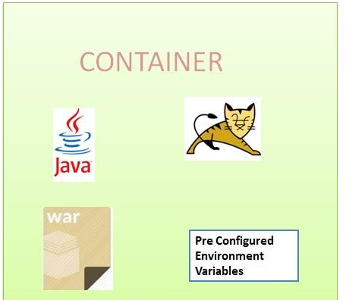
image : docker
An image is a lightweight, stand-alone, executable package that includes everything needed to run a piece of software, including the code, a runtime, libraries, environment variables, and config files.
So an existing fellow developer will create an image of his environment and share it with the new developer.
The new developer will just have to run the image as a docker container.

Slide 27
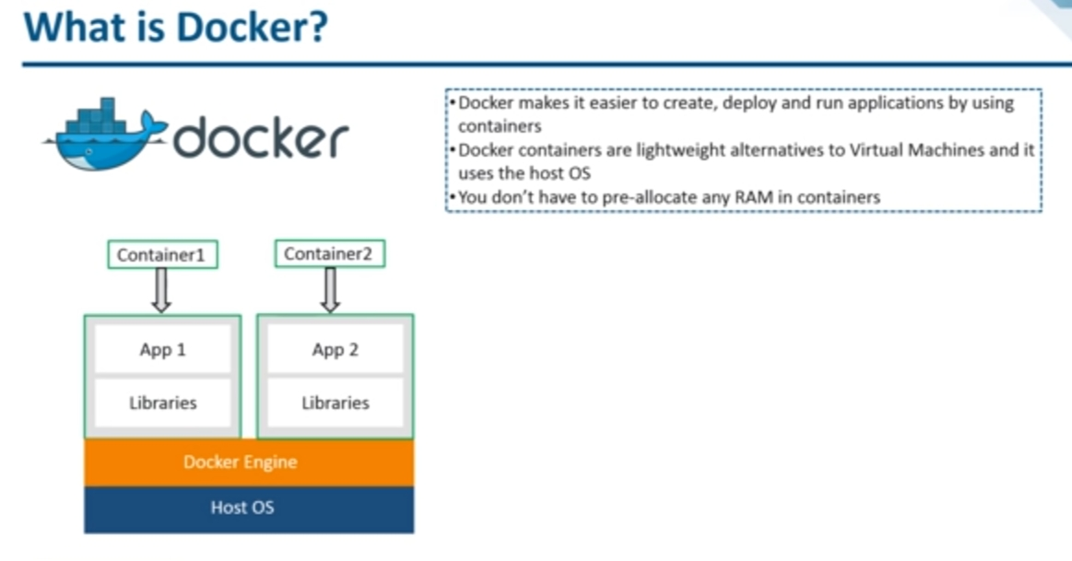

Slide 28
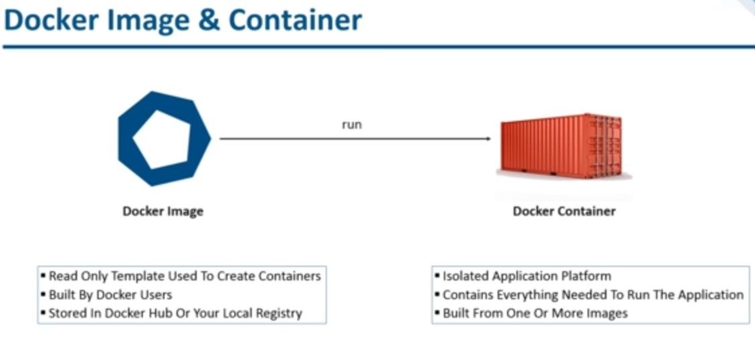

Slide 29
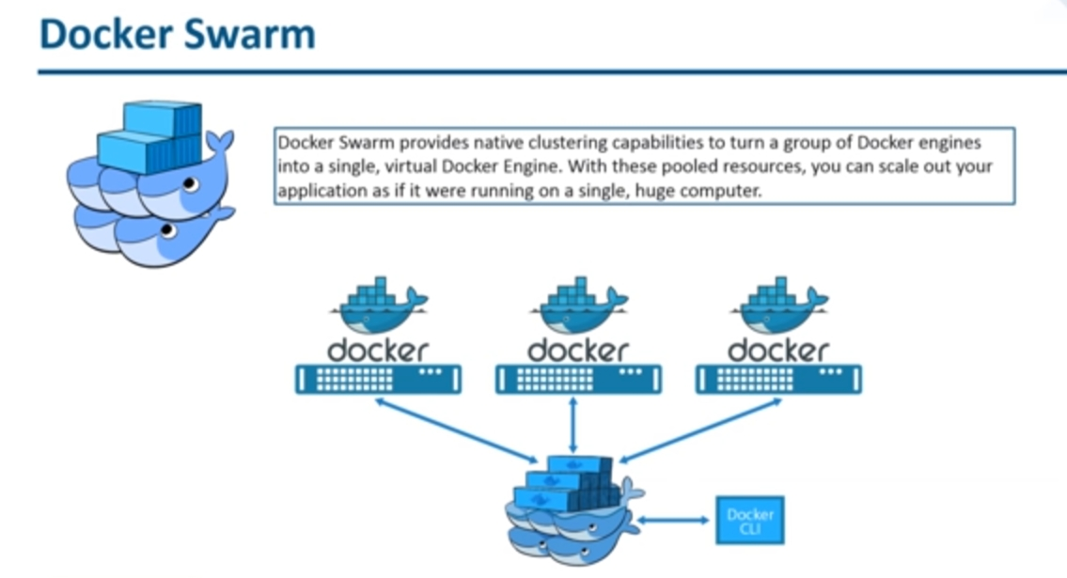

Slide 30
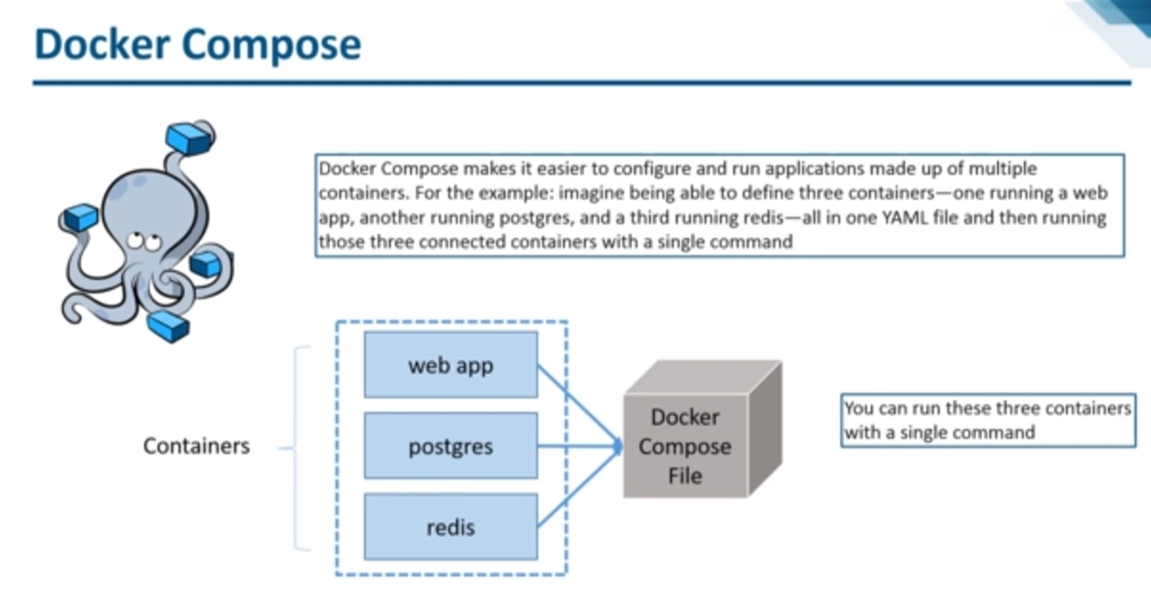

Slide 31
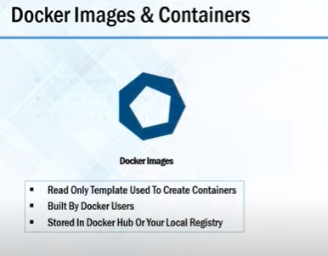
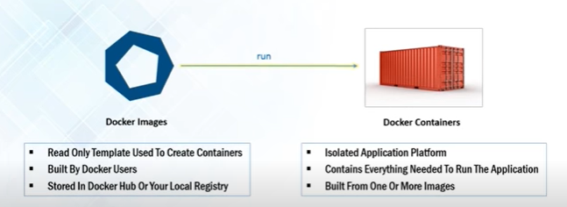
Image & Container : docker

Slide 32
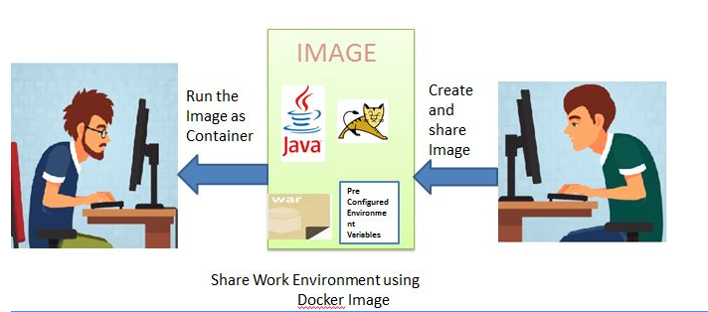
Case study: docker
A container is a runtime instance of an image what the image becomes in memory when actually executed.
It runs completely isolated from the host environment by default, only accessing host files and ports if configured to do so.

Slide 33
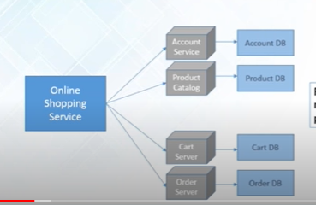
Docker : Case study

Slide 34
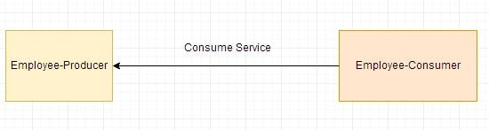
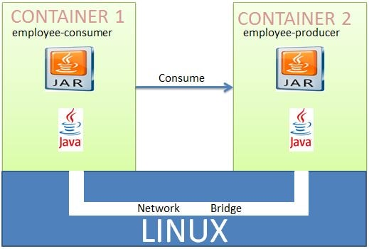
Deploying Multiple Spring Boot Microservices to Docker using Docker Networking

Slide 35
Deploying Multiple Spring Boot Microservices to Docker using Docker Networking
A Docker Container should have only a single service running.
Deploying two microservices employee-producer and employee-consumer to two different containers and then have them interact with each other.

Slide 36
Docker compose
Docker Compose is a tool for defining and running multi-container Docker applications.
With Compose, you use a YAML file to configure your application's services.
Then, with a single command, you create and start all the services from your configuration.
Now again lets check the docker-compose version
$ docker-compose --version

Slide 37
Docker compose
Create docker compose file
[root@centos7 restsql]# cat docker-compose.yml
version: "3"
services:
rest-jdbc:
image: rest-jdbc
ports:
- "8080:8080"
networks:
- country-mysql
depends_on:
- mysqldb
mysqldb:
image: docker.io/mysql:8
networks:
- country-mysql
environment:
- MYSQL_ROOT_PASSWORD=root
- MYSQL_DATABASE=countrydb
volumes:
- ./dbscript:/docker-entrypoint-initdb.d
networks:
country-mysql:

Slide 38
Docker Features
Easy and Faster Configuration
Increase productivity
Application Isolation
Swarm
Routing Mesh
Services
Security Management

Slide 39
Advantages of Docker
It runs the container in seconds instead of minutes.
It uses less memory.
It provides lightweight virtualization.
It does not a require full operating system to run applications.
It uses application dependencies to reduce the risk.
Docker allows you to use a remote repository to share your container with others.

Slide 40
Docker Engine
A server which is a type of long-running program called a daemon process.
The REST API is used to specify interfaces that programs can use to talk to the daemon and instruct it what to do.
A command line interface client.

Slide 41
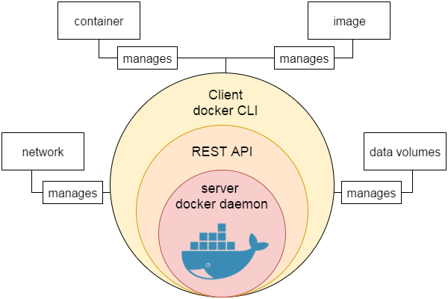

Slide 42
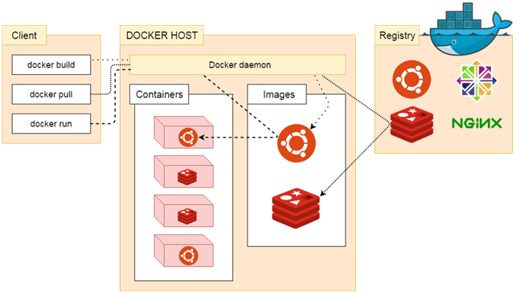
Docker Architecture

Slide 43
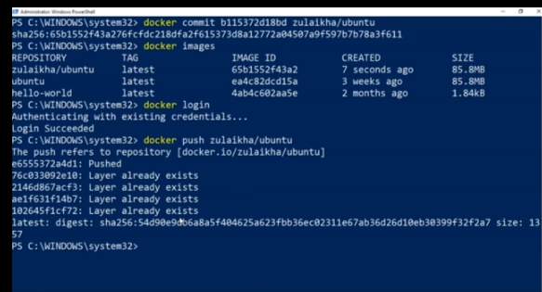

Slide 44
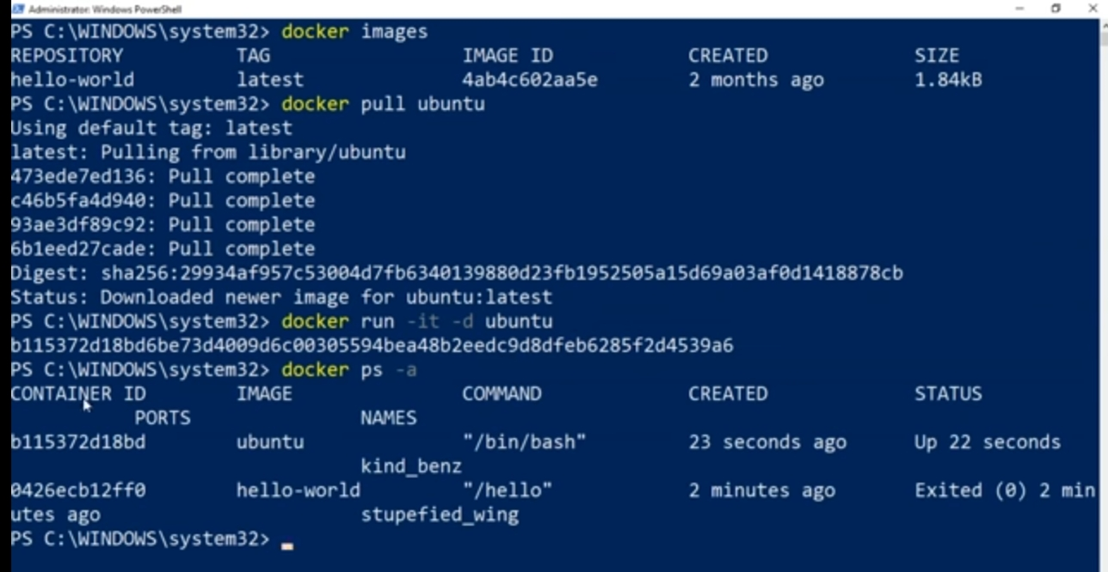

Slide 45
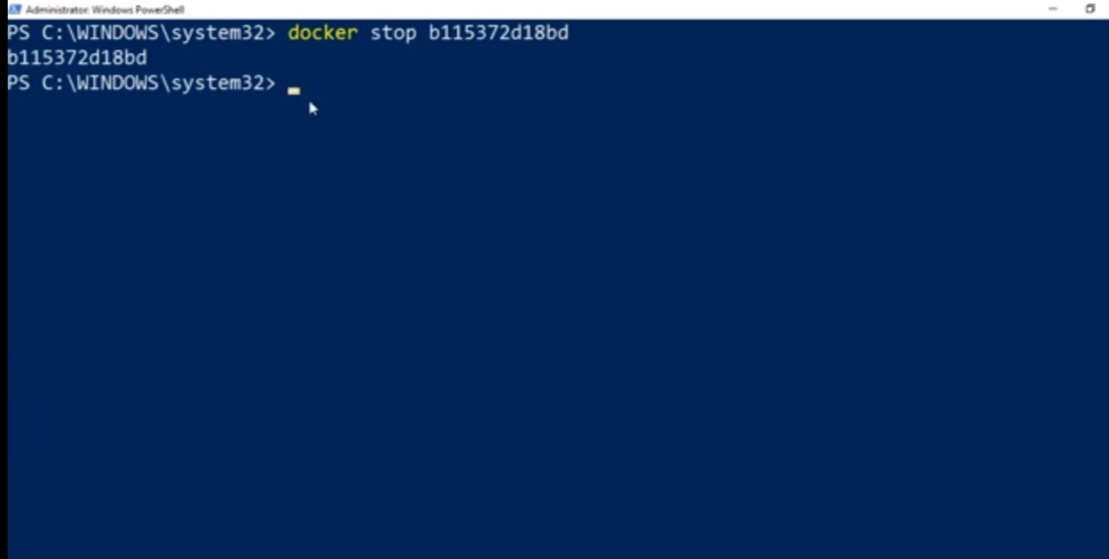

Slide 46
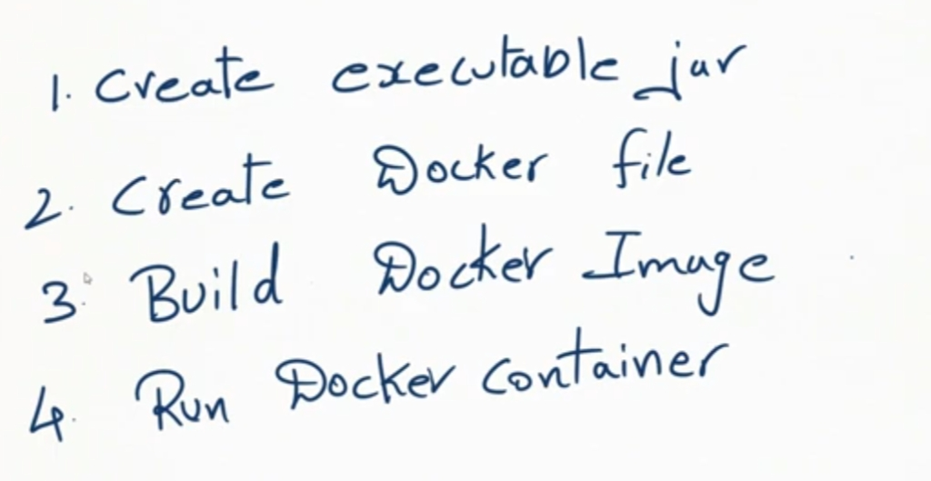

Slide 47
Docker basic commands Ref: https://collabnix.com/docker-cheatsheet/

Slide 48
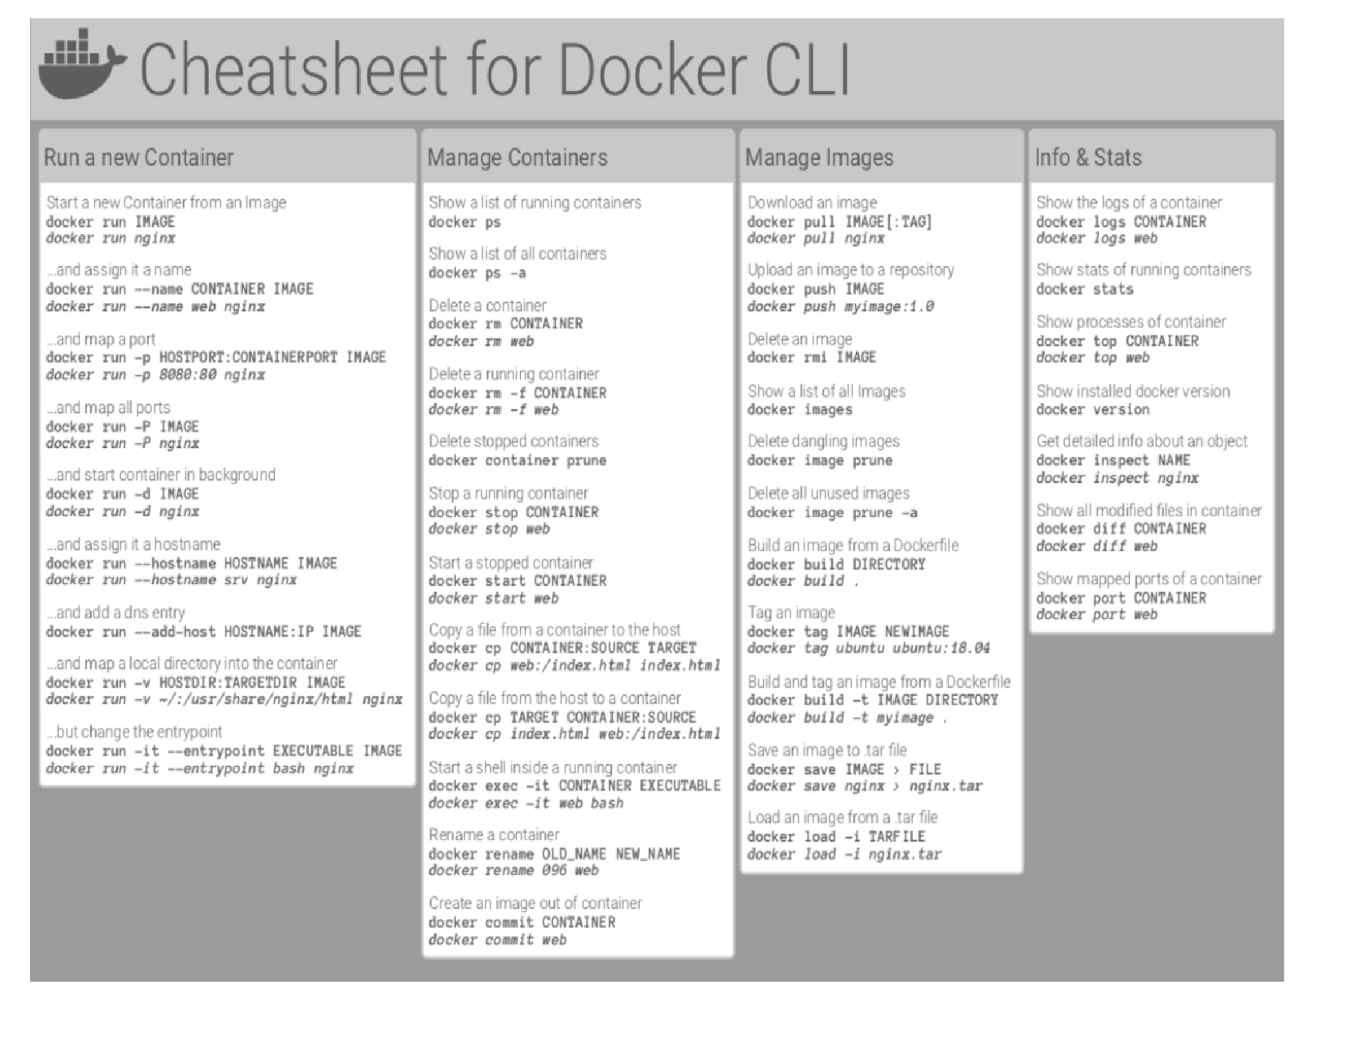

Slide 49
Building & uploading your own docker image
http://localhost/tutorial/our-application/

Slide 50
Integrate docker with Jenkins

Slide 51
